Slide 1
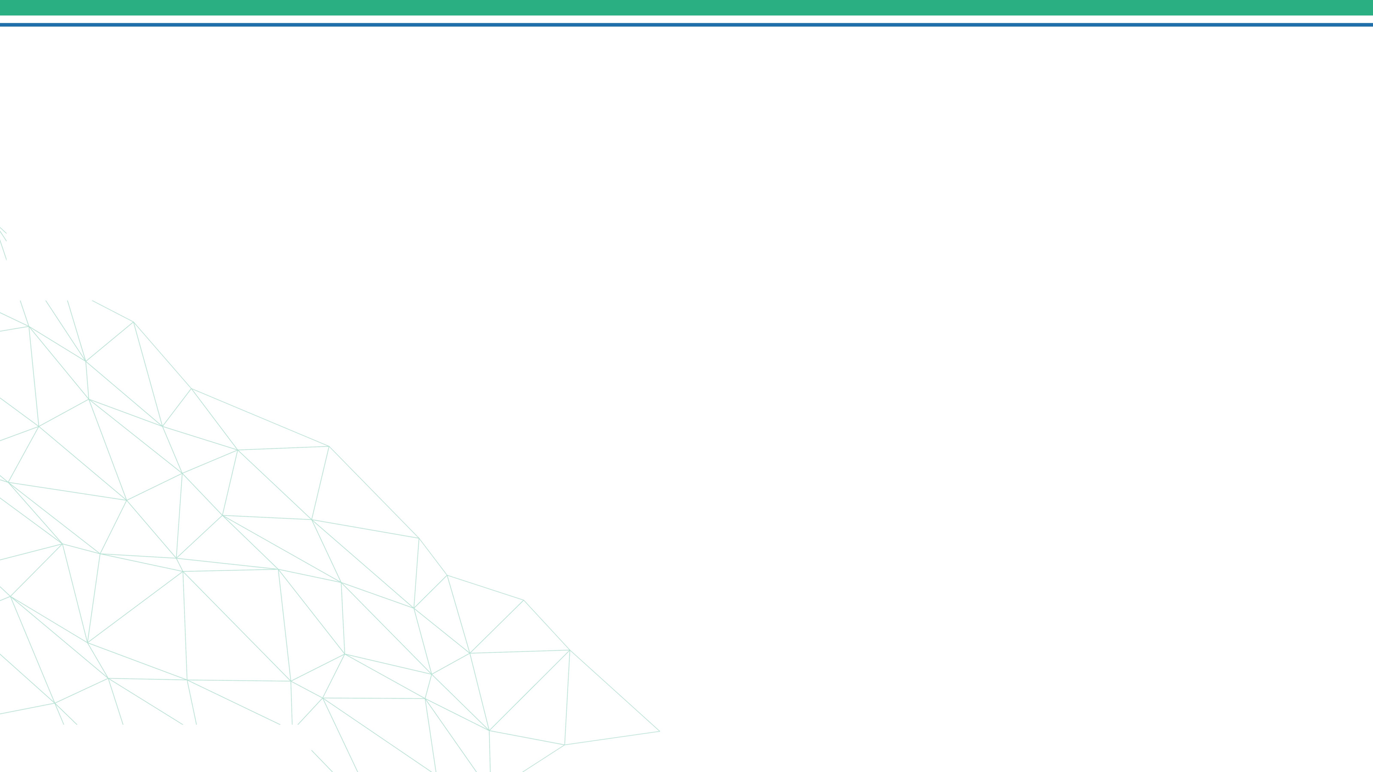


Telecom Customer Churn
16/11/2024
1

Slide 2

Who are we?
Data science final project
Team members :
Ali Abdelsalam - Walid Abdelhameed - Abdelrahman Gamal Mohamed Osama - Ahlam Mohamed
16/11/2024
2

Slide 3
Agenda
Introduction
Project Objective
Dataset Description
Methodologies
Exploratory Data Analysis (EDA) and Visualization
Using Various models
Accuracy
Suggestions and solutions

Slide 4
Introduction
10/21/2024
3

Slide 5

Introduction
Churn
Problem for Telecom Companies.
More expensive to acquire a new customer than to retain an existing one.
Churn Prediction
Popular Big Data Use Case.
Detects customers likely to cancel a subscription to a service.
16/11/2024
4

Slide 6
Project objective

Slide 7

PROJECT OBJECTIVE
Highlighting the main factors influencing Customer Churn through EDA.
Use various ML Algorithms to build prediction models and evaluate the performance of these models.
Find solution to prevent customer churn.
Proposing recommendations and suggestions.
16/11/2024
7

Slide 8
Dataset Description

Slide 9

DATASET DESCRIPTION
Dataset belongs to Company in USA.
Dataset from Kaggle
Source dataset is in csv format.
Dataset contains 7021 rows and 21 columns(3 numeric columns , 18 categorical ).
There is no missing values for the provided input dataset.
Churn is the(target) which notifies whether a particular customer is churned or not.
16/11/2024
9

Slide 10
Data structure & description :
The features in data can be divided into three categories.
Customer demographics
Service details
Contract and billing
customerID
gender
SeniorCitizen
Partner
Dependents
PhoneService
MultipleLines
InternetService
OnlineBackup
OnlineSecurity
DeviceProtection
Streaming TV
Streaming Movies
Tech Support
tenure
Contract
PaperlessBilling
PaymentMethod
MonthlyCharges
TotalCharges
16/11/2024
10

Slide 11
METHODOLOGIES
EDA: 21 variables (continuous & categorical), customer as control.
Visualization: Interactive dashboard in Power BI.
Model Building: Purpose, boundaries, construction, interface, export.
Evaluation: Machine learning algorithm selection & assessment.
Deployment: Streamlit platform.
16/11/2024
11

Slide 12
Visualization

Slide 13
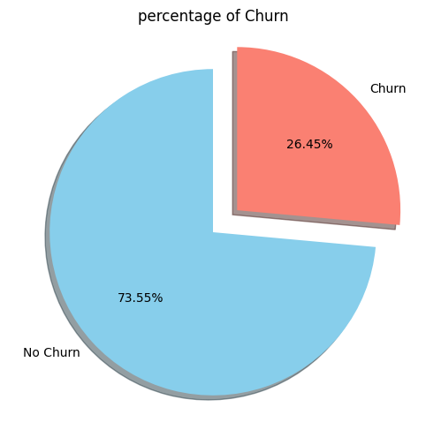
percentage of Churn
We have an issue where over 25% of our customers churn.
16/11/2024
13

Slide 14
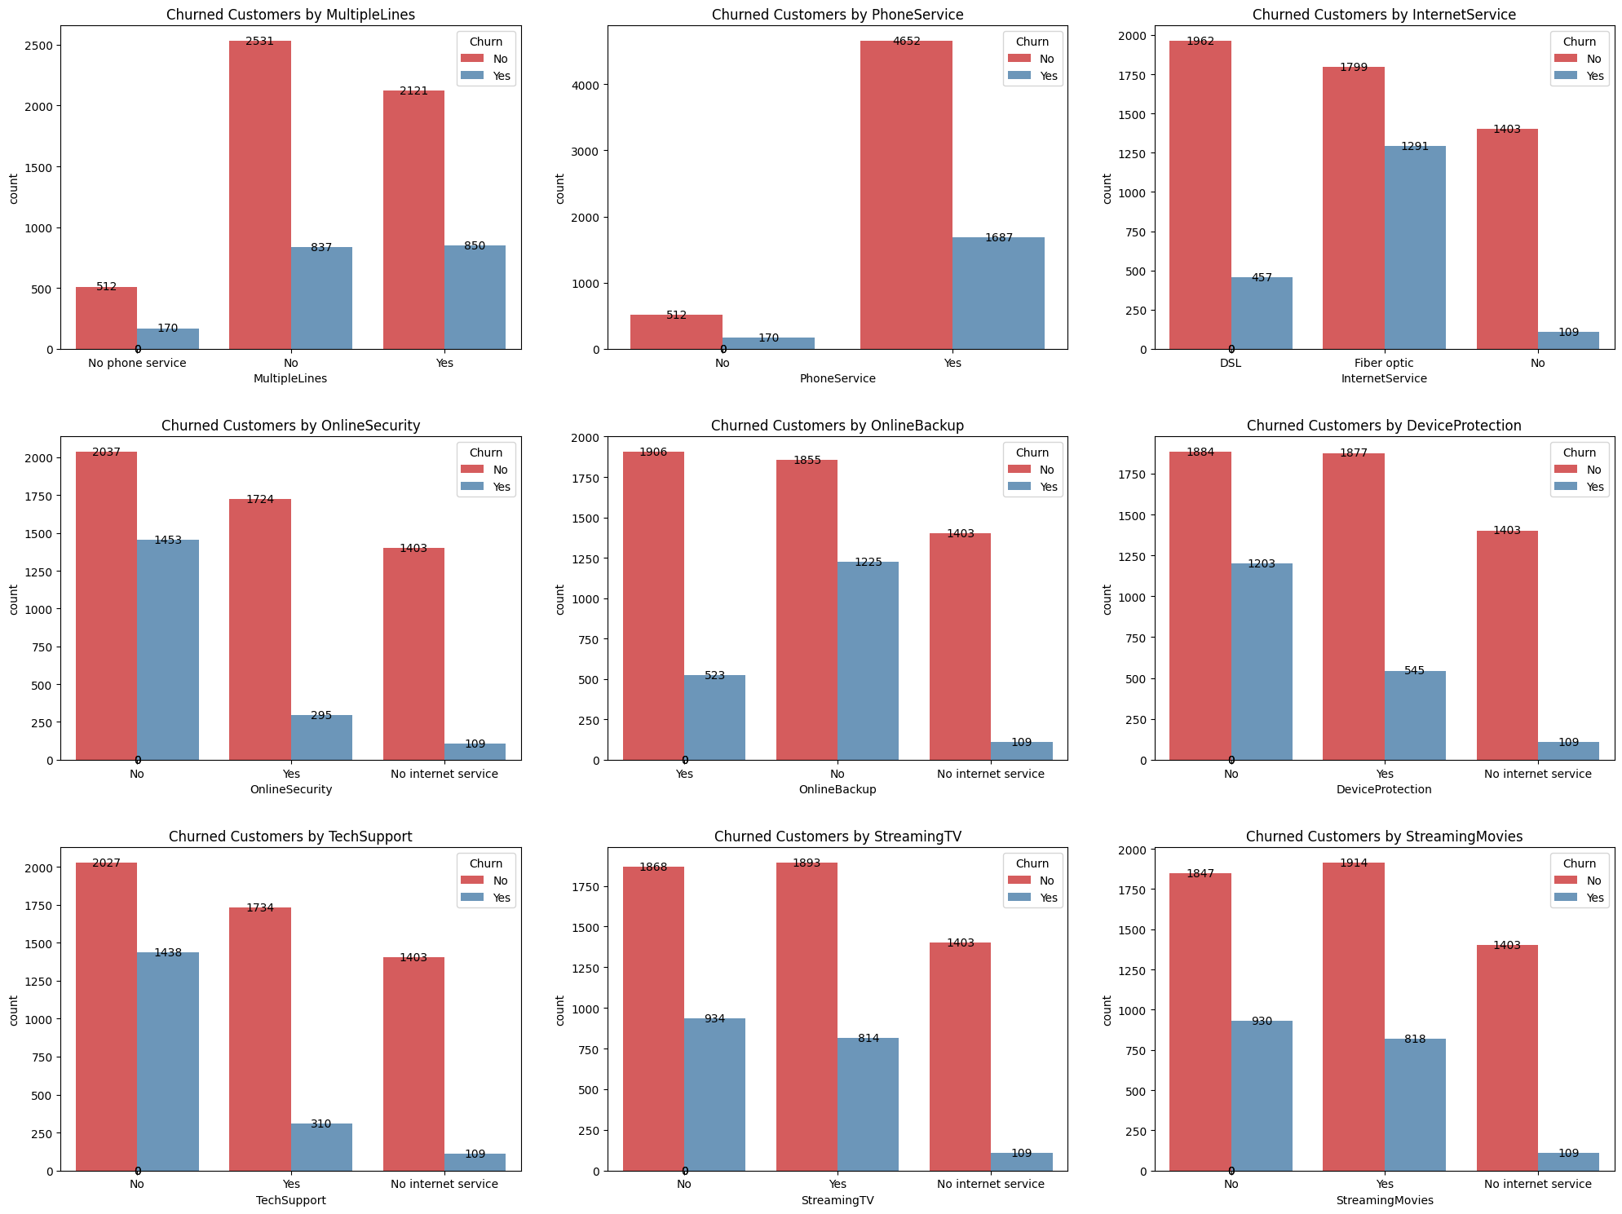
Churned customer by internet service
Nearly 42% of Fiberoptic customers have churned.
16/11/2024
14

Slide 15
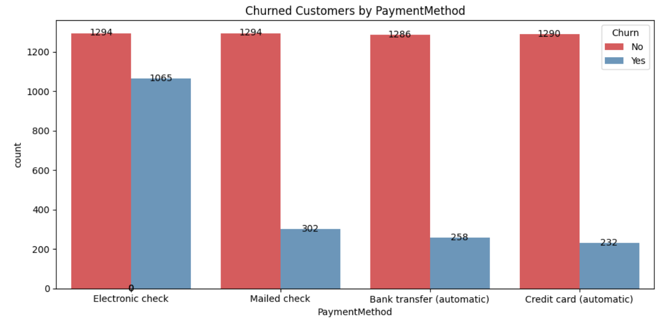
Churned customer by PaymentMethod
Nearly 44% of ElectronicCheck customers have churned.
16/11/2024
15

Slide 16
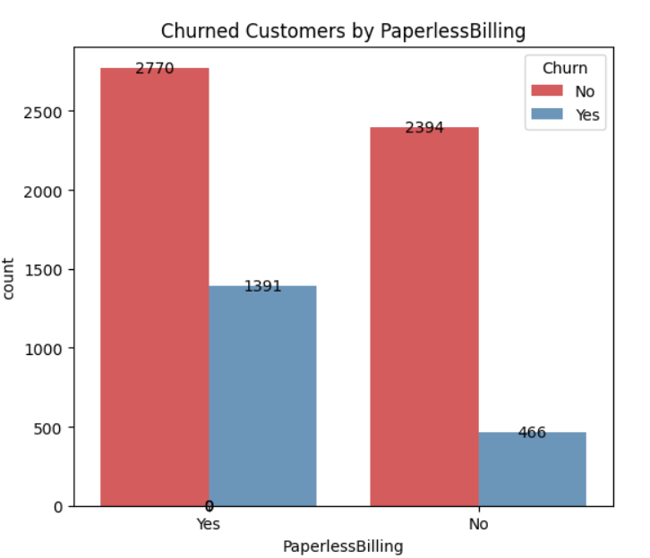
Distribution of Customer by paperless billing
Nearly 33% of people using paperless billing customers
have churned.
16/11/2024
16

Slide 17
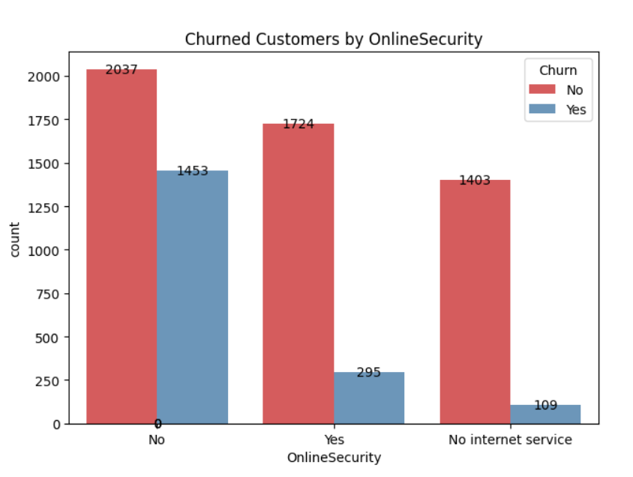
Churned customer by OnlineSecurity
Nearly 41% of customers don’t have OnlineSecurity
have Churned .
16/11/2024
17

Slide 18
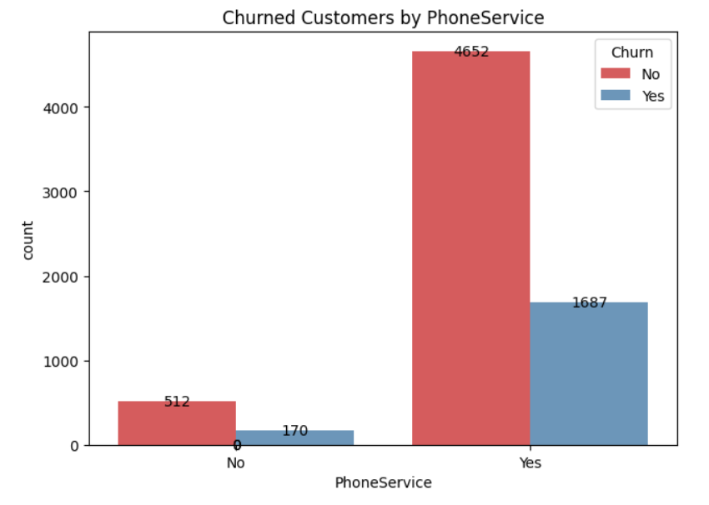
Churned Customer by PhoneService
Nearly 26% of customers have phone service
have Churned .
16/11/2024
2

Slide 19
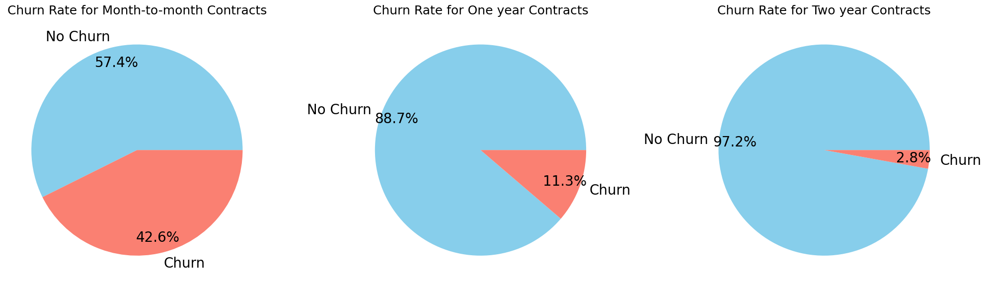
the relation between the contract period and and churn
The pie charts indicate that churn increases with short-term contracts, reaching nearly 42%, while it decreases significantly for two-year contracts.
16/11/2024
2

Slide 20
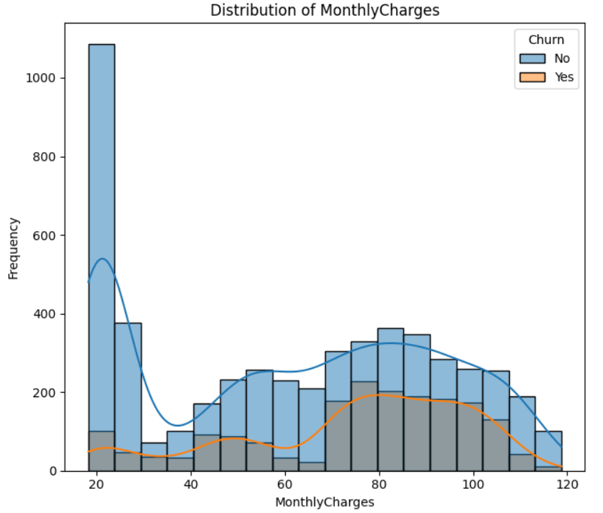
Distribution of MonthlyCharges
Customers with low monthly charges tend to stay, while those with charges around $70-$100 may experience higher churn rates.
16/11/2024
2

Slide 21
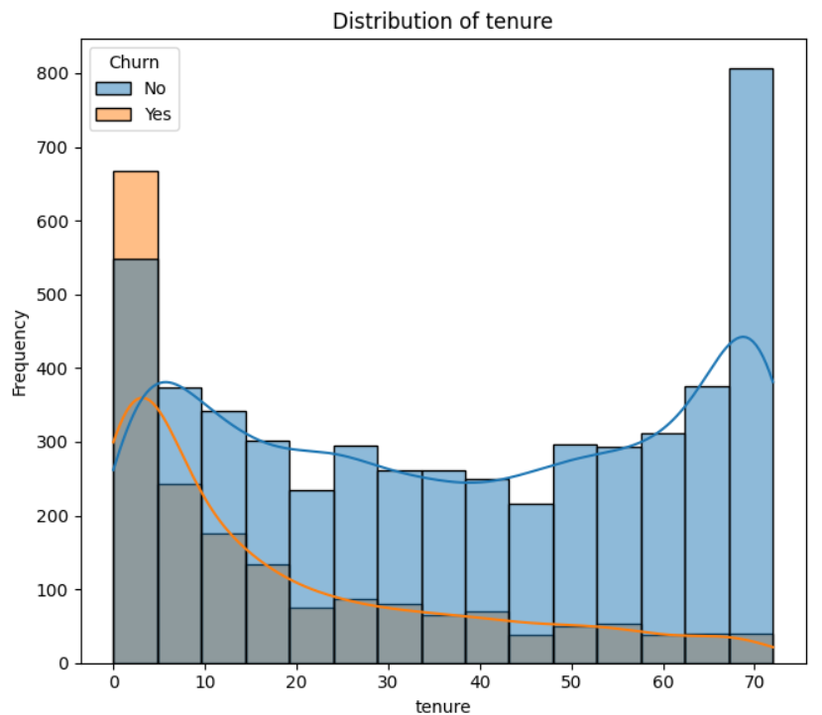



Distribution of tenure
Number of months increase
Customer churn percentage decrease.
During the initial 1 year, customers are likely to disengage from the company
16/11/2024
2

Slide 22
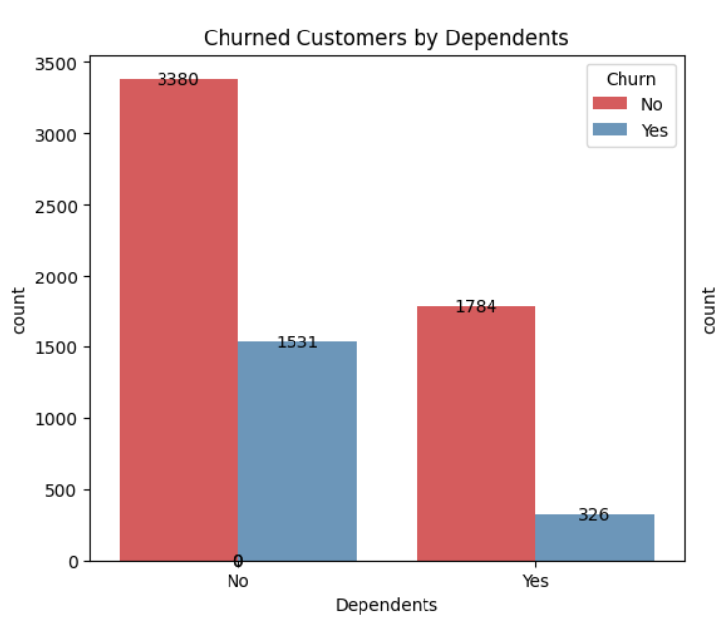
Churned customer by dependents
Customers without dependents 39% have a higher churn rate compared to those with dependents.
16/11/2024
2

Slide 23
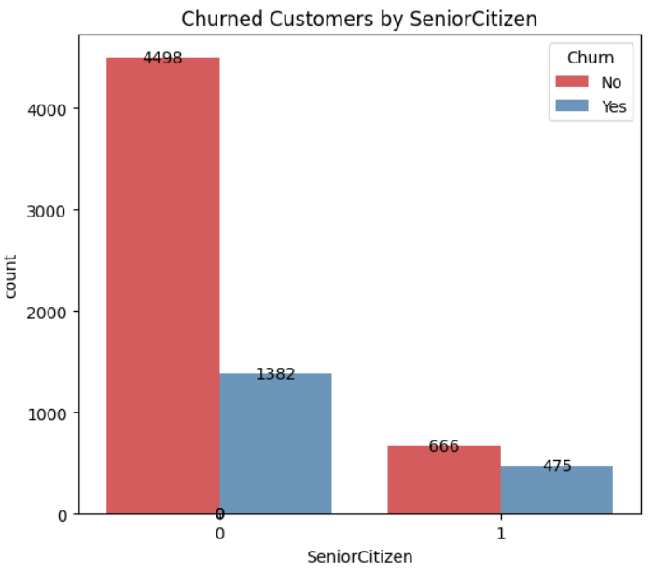
Churned customer by SeniorCitizen
nearly 23% of Juniors are more likely to churn.
16/11/2024
2

Slide 24
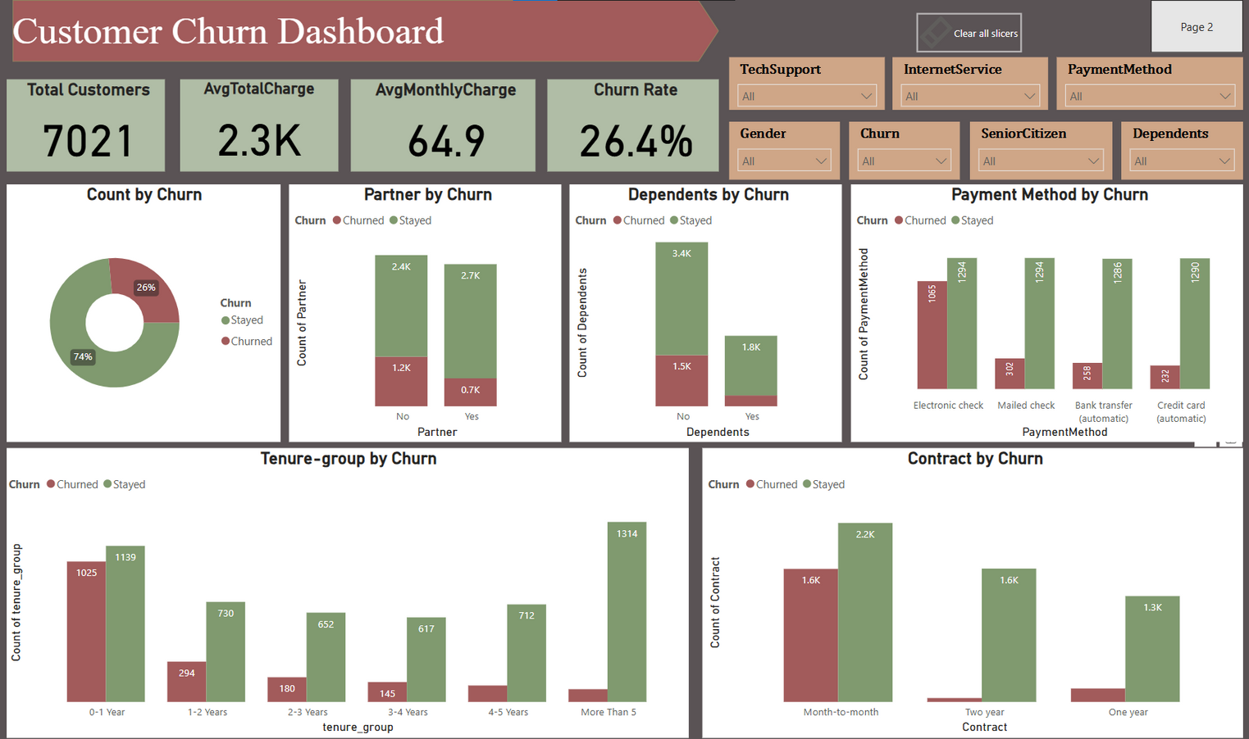

Dashboard
Click here to show the Interactive dashboard
16/11/2024
2

Slide 25
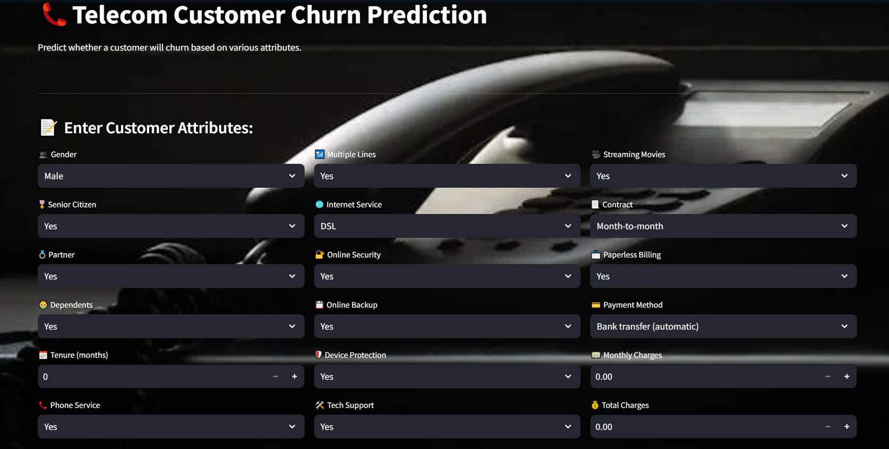

Home Page Deployment
Click here to show the app
16/11/2024
3

Slide 26
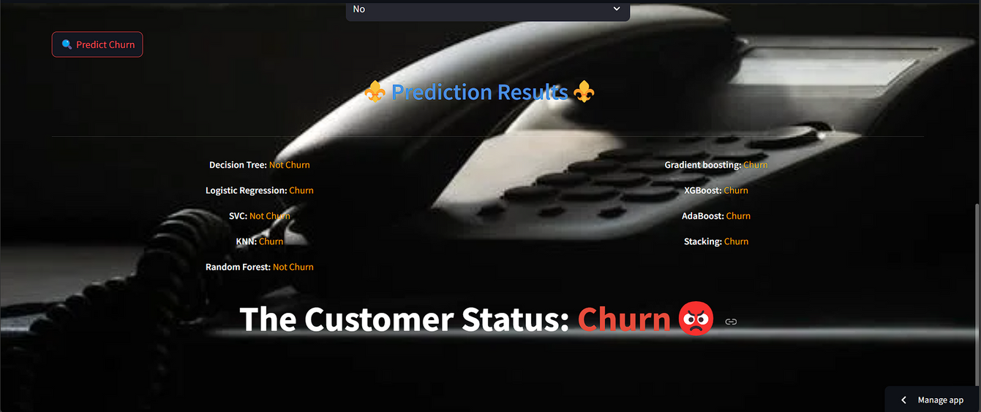
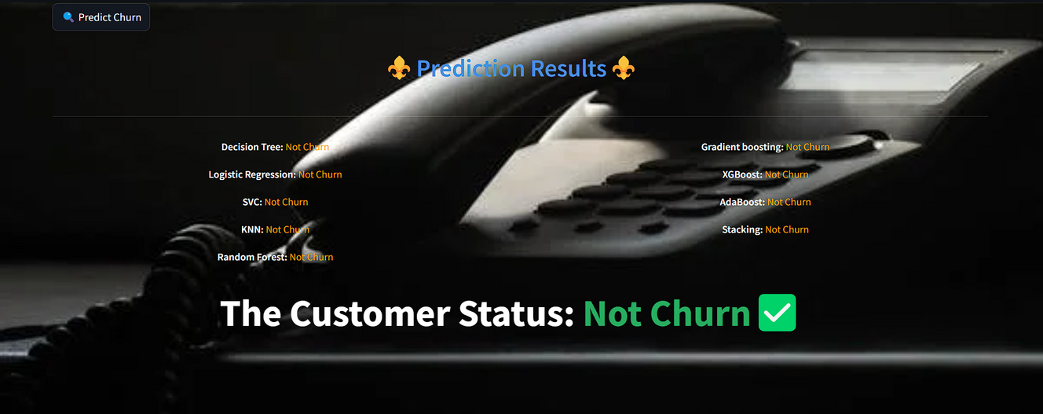
Life application
Output:
The application shows predictions from multiple models, choosing the most common result to improve churn prediction reliability.
16/11/2024
13

Slide 27
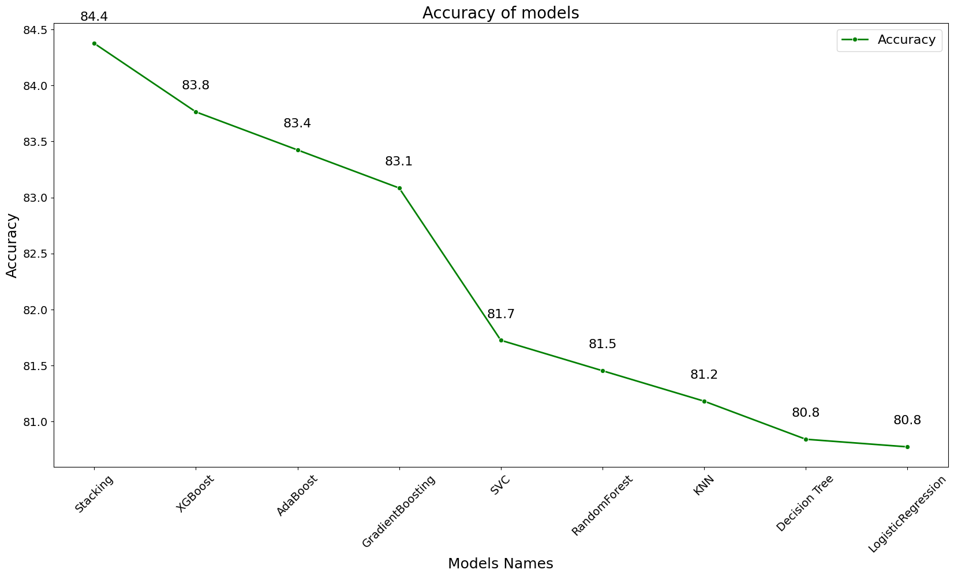

16/11/2024
13

Slide 28

Suggestions
HOW TO REDUCE CUSTOMER CHURN

Slide 29

Enhancing Services and Customer Experience
Contract promotion: Grap customer attention for best package.
Fiberoptic Quality: Invest in high-quality infrastructure and offer retention-focused benefits.
Automated Payments: Incentivize auto-payment methods for customer convenience and retention.
Digital Engagement: Provide interactive, paperless statements with personalized tips.
Online Security: Protect customers with advanced security tools and updated software.
Tailored Pricing: Offer flexible bundles and tiered plans for high-usage customers.
16/11/2024
12

Slide 30
Boosting Loyalty and Preventing Churn
Loyalty Programs: Retain long-term customers with personalized rewards.
Support for Seniors: Simplify billing and provide discounts for senior customers.
Re-engage Churned Customers: Develop strategies to win back lost customers.
Customer Feedback: Continuously gather input to improve services and technical support.
Churn Prevention: Reduce costs for dependents and offer proactive engagement.
Predictive Analysis: Prepare solutions for potential business changes.
16/11/2024
12

Slide 31
Programming Languages + Frameworks :
Programming Languages
Python
Frameworks/Tools:
Scikit-learn: For implementing machine learning models.
Pandas & NumPy: For data manipulation and analysis.
Matplotlib & Seaborn & plotly: For creating visualizations.
Streamlit: For deploying interactive web applications.
Power BI: For creating interactive dashboards.
Github: hosting Streamlit page.
Kaggle: data collection.
Canva : presentation.
16/11/2024
12

Slide 32
List of reports and documentation
App Link:
click here to go to the app
Dashboard Link:
click here to go to the Dashboard
Notebook Link:
click here to go to the Notebook
Report Link :
click here to go to the report

Slide 33
contact us :
Ali Abdelsalam: aliabdsalam2003@gmail.com
Walid Abdelhameed: waleedabdelhameed43@gmail.com
Abdelrahman Gamal: Abdog814@gmail.com
Mohamed Osama: mohamed.osama.hossni@gmail.com
Ahlam Mohamed: ahlamm947@gmail.com

Slide 34
Thank you!
Do you have any questions for us?

